Slide 1
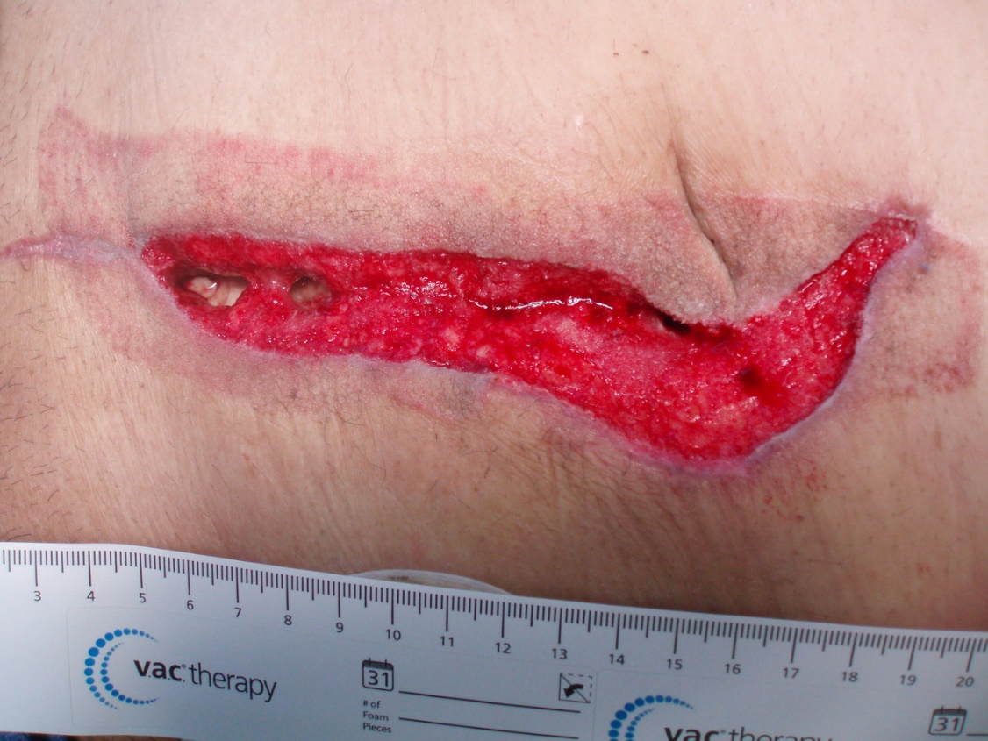
Wound Healing
BY MBBSPPT.COM

Slide 2
WOUND REPAIR IS THE EFFORT OF INJURED TISSUES TO RESTORE THEIR
NORMAL FUNCTION AND STRUCTURAL INTEGRITY AFTER INJURY.
  Although regeneration is the goal of wound healing, it is found only in embryonic development, in lower organisms , or in certain tissue compartments such as bone & liver.
  In adult humans, however, the Accuracy of regeneration is sacrificed because of the urgency to return to function.

Slide 3
CLASSIFICATION OF WOUNDS
I. RANK AND WAKEFIELD CLASSIFICATION
Tidy Wounds - Surgical Incisions Caused By Sharp Objects - Incised, Clean, Healthy Wound Without Any Tissue Loss - Healing Is By Primary Intention.
Untidy Wounds - They Are Due To:
Crushing, Tearing, Avulsion.
Devitalised Injury, Vascular Injury, Burns.
Liberal Excision Of Devitalised Tissue-
Heal By Secondary Intention.

Slide 4
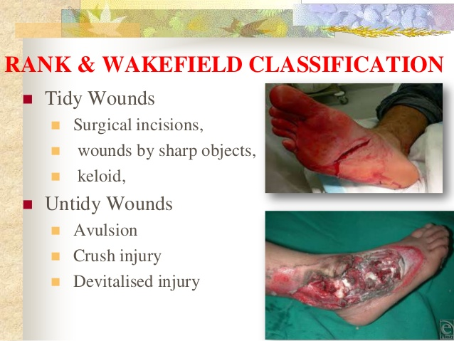

Slide 5
CLASSIFICATION OF WOUNDS
II. Classification Based On Type Of Wound
Clean Incised Wound
Lacerated Wounds
Bruising And Contusion
Hematoma
Closed Blunt Injury.
Puncture Wounds And Bites
Abrasion
Traction And Avulsion Injury
Crush Injury
Gunshots, Bone Injuries Open Or Closed
Penetrating Wounds

Slide 6
CLASSIFICATION OF WOUNDS
III. Classification Based On Thickness Of The Wound
Superficial – Only Epidermis & Dermal Papillae
Partial Thickness – Deeper Dermis, Hair Follicles And Sweat Glands Are Left Behind
Full Thickness – L/O Skin And Subcut.
Deep Wounds – Deep Fascia, Muscles, Deeper Tissue Are Involved
Penetrating Wounds – Into Organs, Cavities
Complex Wounds – Involving Vessels, Nerves

Slide 7
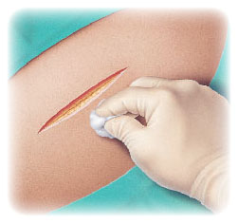
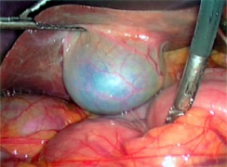
CLASSIFICATION OF WOUNDS
IV. Classification Of Surgical Wounds Clean Wound
Herniorrhaphy. Excisions. Surgeries of the brain, joints, heart transplant.
*Infective rate is less than 2%.
Clean Contaminated Wound Appendicectomy, Bowel Surgeries, Gallbladder & Pancreatic Surgeries.
*Infective Rate Is 10%.

Slide 8
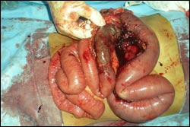
CLASSIFICATION OF SURGICAL WOUNDS
Contaminated Wound
Acute abdominal conditions, open fresh accidental wounds.

Slide 9
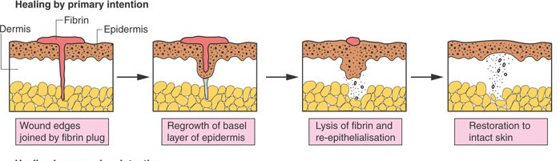
Types of Wound Healing
Primary Healing (First Intention):
  Clean incised wound or surgical wound
  More epithelial regeneration than fibrosis.
  Wound heals rapidly with complete closure.

Slide 10
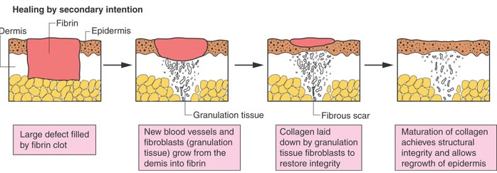
Types of Wound HealinG
Secondary Healing (Second Intention):
  Occurs in a wound with extensive soft tissue loss.
  Heals slowly with fibrosis.
  It leads into a wide scar, often hypertrophied and contracted.

Slide 11
Types of Wound Healing
Healing by third intention [tertiary wound healing or delayed primary closure].
These occur in wounds which are left open for debridement.
After wound debridement and control of local infection, wound is closed with sutures or covered using skin graft.

Slide 12
PHASES OF WOUND HEALING
Phase of inflammation ( 1 – 3 days).
Phase of proliferation ( 3 days – 3 wk.).
Phase of remodeling ( 3wk – 2 yrs).
Acute wound – proceed in orderly process – achieve sustained restoration of structure & function.
Chronic wound – stops in inflammatory phase – doesn’t proceed to closure.

Slide 13
In a large wound we can appreciate all the 3 phases of wound healing.
For Ex. In A Pressure Sore
  Fibrinous exudate – inflammatory phase
  Granulation – proliferative phase
  Advancing edge – remodeling phase
*Occasionally Some Describe 2 More Phases
  Hemostatic phase
  Destructive phase

Slide 14
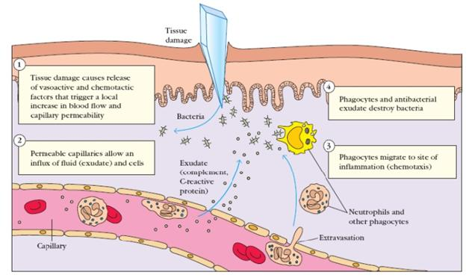
INFLAMMATORY PHASE (REACTIVE PHASE)
Characterized By
  Hemostasis.
  Increased vascular permeability.
  Migration of cells into the wound by chemotaxis.
  Secretion of cytokines and growth factors into the wound.
  Activation of the migrating cells.

Slide 15
INFLAMMATORY PHASE (REACTIVE PHASE)
HEMOSTASIS
In acute injury blood vessel damage.
Initial intense local vasoconstriction of arterioles and capillaries followed by vasodilation and increased vascular permeability.
Erythrocytes & platelets adhere to the damaged capillary endothelium - results in plugging of capillaries leading to cessation of haemorrhage.
Activation of these platelets by binding to the exposed type iv and v collagen from the damaged endothelium results in platelet aggregation.

Slide 16
INFLAMMATORY PHASE (REACTIVE PHASE)
INCRESED VASCULAR PERMEABILITY
Platelet binding causes conformational changes.
Trigger intracellular signal transduction pathways lead to platelet activation.
Release of pdgf, tgfβ, igf-i, fibronectin, fibrinogen, vwf mast cells release histamine, serotonin.
Results in increased vascular permeability & vasodilation – leakage of plasma into ecf.
Leads to clinical findings of inflammation rubor, tumor, calor, dolor.

Slide 17
INFLAMMATORY PHASE (REACTIVE PHASE)
Chemotaxis:
  Damaged keratinocytes release macrophage chemoattractant protien mcp-1 or ccl-2.
  Potent chemoattractant for macrophages, t-lym, mast cells.
  Cxcl-1 is potent chemoattractant for pmns.
Inflammatory Cells:
  Pmns.
  Macrophages.
  Lymphocytes.

Slide 18
INFLAMMATORY PHASE (REACTIVE PHASE)
Inflammatory Cells – Neutrophils:
Complement factors c5a & lkt b4, c4, d4, tnf-α, il-1 promote pmn adhesion to endothelium.
Pmns migrate through the extracellular matrix.
Functional activation after migration.
Activated neutrophils scavenge for necrotic debris, foreign material and bacteria.
Generate free o2 radicals.
Migration stops when wound contamination has been controlled – usually first few days.
Pmns do not survive more than 24hrs – after 24-48 hrs mononuclear cells are more predominant.

Slide 19
INFLAMMATORY PHASE (REACTIVE PHASE)
Inflammatory Cells – Macrophages:
Most crucial in wound healing.
They appear at the same time that pmns appear.
They induce apoptosis of pmns.
Wound decontamination through phagocytosis.
Apc - ingestion and processing of antigens for t-lymphocytes.
Release mmp(matrix metallo proteinases) – regulates ecm turnover – this activity is camp mediated - can be blocked by nsaids.
Secrete 1) cytokines 2) growth factors.

Slide 20
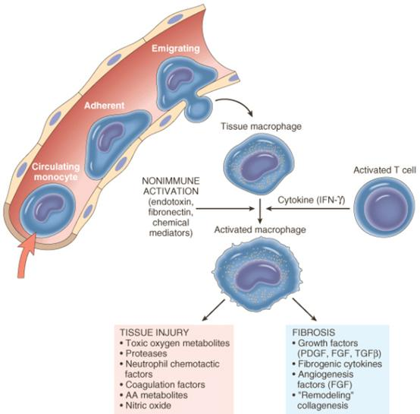
INFLAMMATORY PHASE (REACTIVE PHASE)
Macrophages:

Slide 21
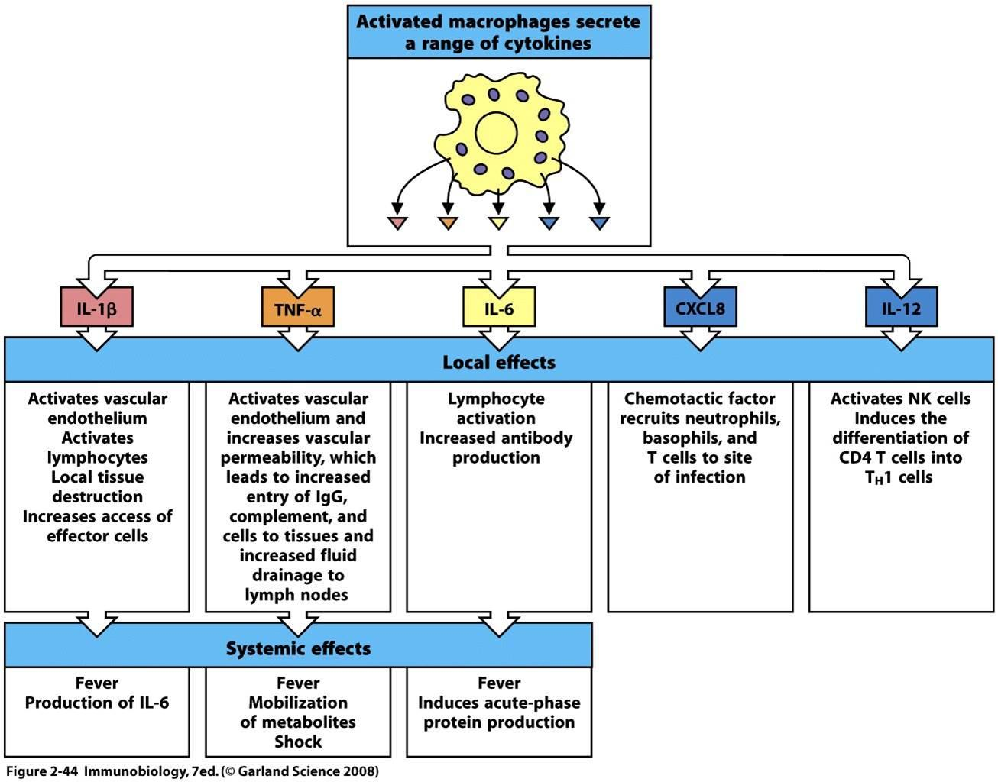

Slide 22
INFLAMMATORY PHASE (REACTIVE PHASE)
Inflammatory Cells – Lymphocytes (T Lym):
Appear by 5th day…peaks by 7th day.
B lym – not much significant role in wound healing – seem to downregulate healing as the wound closes.
Most of their effects on fibroblasts by releasing stimulator cytokines like il-2.
Inhibitor cytokines like tgfβ, tnfα, ifnγ.
Infγ is an imp mediator in chronic nonhealing wounds.

Slide 23
PROLIFERATIVE PHASE (REGENERATIVE PHASE)
This phase is characterized by formation of granulation tissue.
Granulation tissue consists of capillary bed, fibroblasts, macrophages, loosely arranged collagen, fibronectin, hyaluronic.
3 Main Processes In This Phase:
Angiogenesis.
Fibroplasia.
Epithelialization.

Slide 24
PROLIFERATIVE PHASE (REGENERATIVE PHASE)
Angiogenesis:
Formation of new blood vessels at the site of injury by proliferation of endothelial cells from margins of damaged blood vessels.
Angiogenesis stimulated by cytokines released by macrophages – tnfα.
Vegf – most potent – released by keratinocytes, macrophages, endothelial cells etc.
Capillary tube formation involves cell-cell and cell-matrix interactions.
Cell-cell interaction is modulated by pecam-1 (platelet endothelial cell adhesion molecule.
Cell matrix interaction modulated by β1 integrin.
Some of the capillaries differentiate into venules and arterioles, others degenerate.

Slide 25
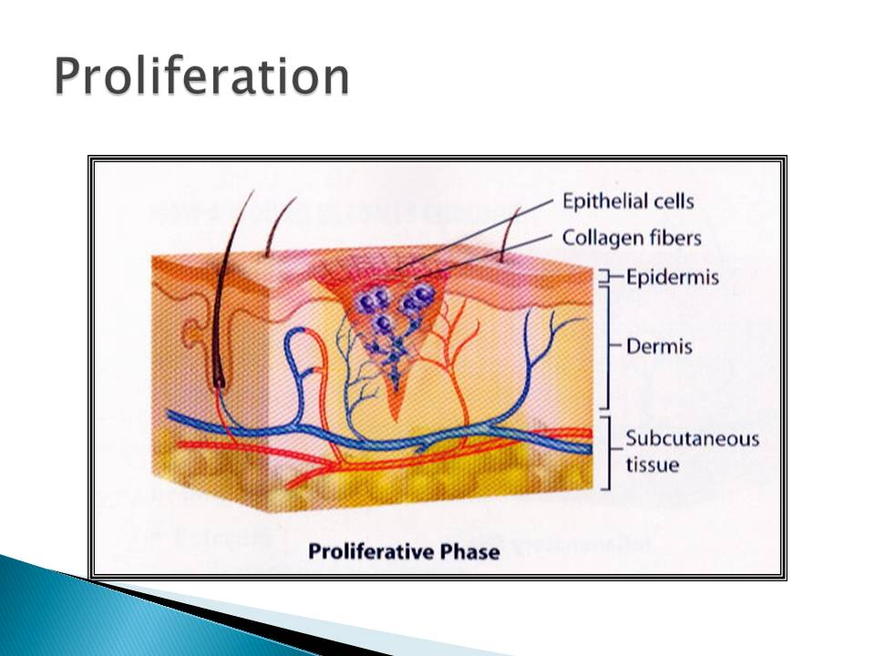
PROLIFERATIVE PHASE (REGENERATIVE PHASE)

Slide 26
PROLIFERATIVE PHASE (REGENERATIVE PHASE)
Fibroplasia:
Fibroblasts do not appear at the wound site by diapedesis.
They are differentiated cells from the resting mesenchymal cells.
Stimulation by macrophages, pdgf – activation of fibroblast grom g0 phase – replication and proliferation.
Produce collagen & other components of ecm.

Slide 27
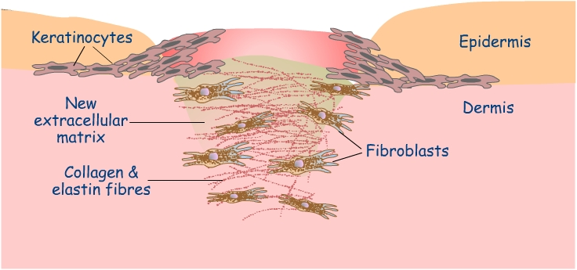
PROLIFERATIVE PHASE (REGENERATIVE PHASE)

Slide 28
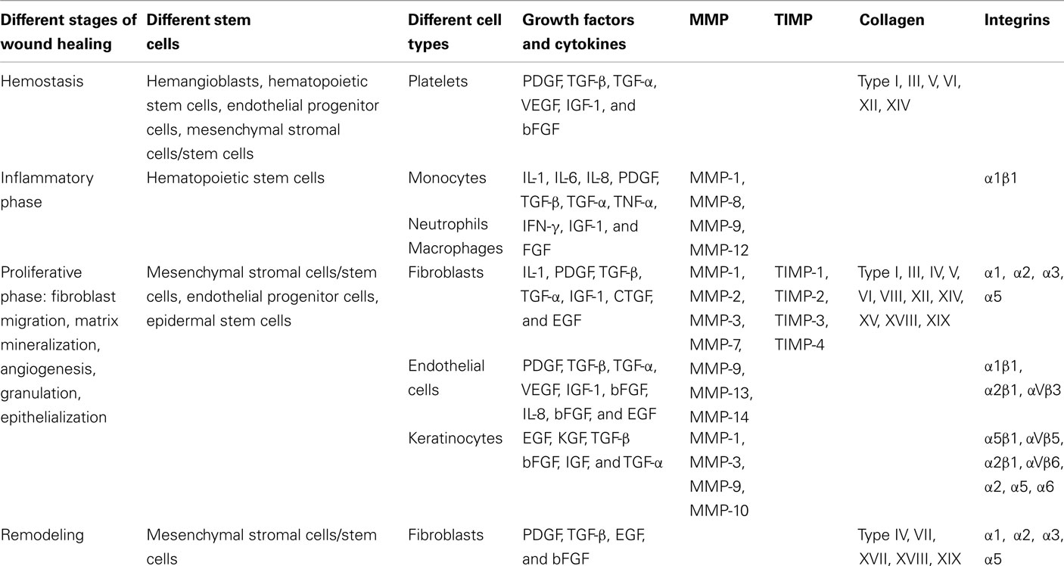

Slide 29
PROLIFERATIVE PHASE (REGENERATIVE PHASE)
Epithelialization:
  Involves sequence of changes in wound keratinocytes – detachment, migration, proliferation, differentiation & stratification.
  Migrating cells separate the desiccated eschar from the viable tissue.

Slide 30
MATURATIONAL PHASE (REMODELLING PHASE)
Scar Contraction With Collagen Cross Linking, shrinking And Loss Of Edema Occurs In This Phase.
Main Events:
Scarring.
Contraction.
Remodeling of the scar.

Slide 31
MATURATIONAL PHASE (REMODELLING PHASE)
  Maturation of collagen by crosslinking is responsible for tensile strength.
  Initially fibronectin, proteoglycan deposition occurs later replaced by collagen.
  Normal skin 80% ty 1 collagen 20% ty 3 collagen.
  Granulation tissue more of type 3 collagen.
  Scar contains equal proportions.
  Basic components of collagen 1) lysine 2) proline.
  Hydroxylation and later glycosylation of lysine occurs.
  Hydroxylation requires adequate vit c.. iron.. A ketoglutaric acid.

Slide 32
MATURATIONAL PHASE (REMODELLING PHASE)
  Wound contraction occurs by centripetal movement of whole thickness of skin thus reducing the size of disorganized scar if wound area is very large there may be contractures, physical limitation remodeling – fibroblast population decreases.
  Wound strength increases within 1-12 weeks.
  3% - 1 week,20% - 3weeks, 80% by 12 weeks.
  But the tensile strength will be only 30 % and less elastic when compared with normal skin.

Slide 33
ABNORMAL WOUND HEALING
  Wound contraction occurs by centripetal movement of whole thickness of skin thus reducing the size of disorganized scar if wound area is very large there may be contractures, physical limitation remodeling – fibroblast population decreases.
  Wound strength increases within 1-12 weeks.
  3% - 1 week,20% - 3weeks, 80% by 12 weeks.
  But the tensile strength will be only 30 % and less elastic when compared with normal skin.

Slide 34
ABNORMAL WOUND HEALING
KELOID
HYPERTROPHIC SCAR
Abnormal scar grows beyond boundaries of wound site & continues to grow even after 6 months.
Immature fibroblasts/type 3 collagen.
Common in Africans, genetic predisposition, females.
Vascular, tender, itching.
Sternum, deltoid, upper back increased susceptibility.
These areas have increased levels of muscle & skin tension.
Growth limits up to 6 months.
Not familial/genetically predisposed.
Raised scar that doesn’t extend beyond original boundaries.
No tenderness, itching, vascularity.
Regress spontaneously if the stimulating factor is removed.

Slide 35
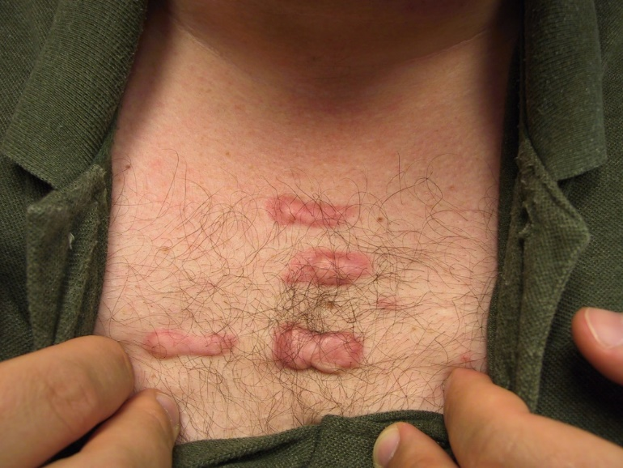
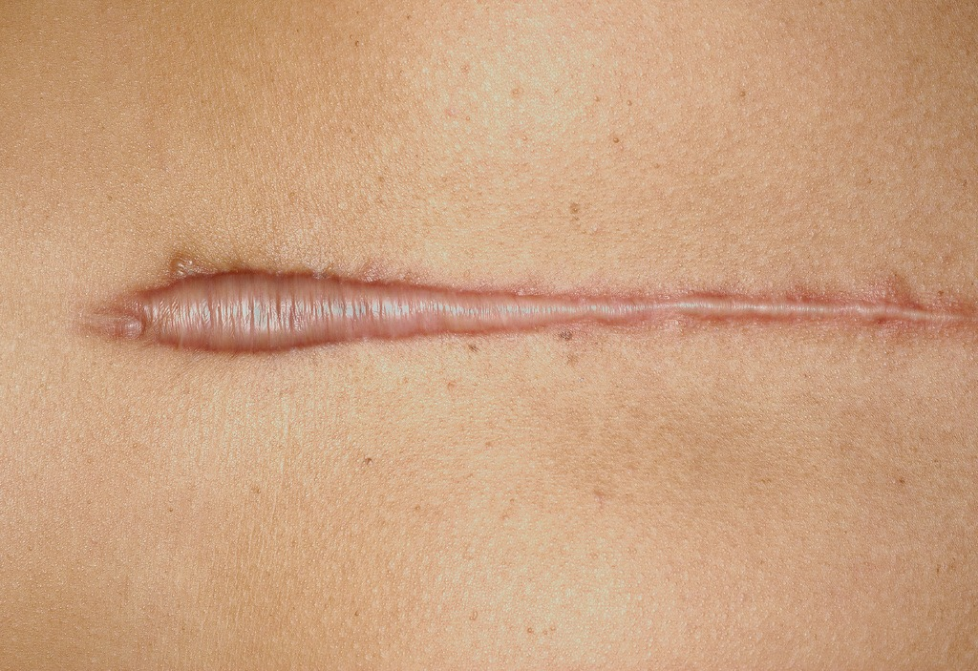

Slide 36
ABNORMAL WOUND HEALING
KELOID TREATMENT
HYPERTROPHIC SCAR TREATMENT
Intralesional steroids.
Intralesional excision( retaining the scar margin).
Laser-make them look less red and flatten.
Interferons – research.
Fluorouracil.
Regress spont if stimulating factor is removed.
Compression therapy.
Topical steroids.
Silicon gel sheeting.
Surgery.
Laser.
Topical vit E.

Slide 37
ABNORMAL WOUND HEALING
Chronic Non Healing Wounds:
Def – wounds that have failed to proceed through an orderly and timely reparative process to produce anatomical & functional integrity over a period of 3 months.
  Derangements in various stages.
  Increased/decreased levels of cytokines, growth factors, proteinases.

Slide 38
ABNORMAL WOUND HEALING
LOCAL
SYSTEMIC
  Infection.
  Site of wound.
  Venous/lymph stasis.
  Ischemia.
  Tissue tension.
  Poor opposition.
  Topical agents.
  Ionizing radiation.
  Foreign bodies.
  Age, obesity, smoking.
  Malnutrition, vit def.
  Dm.
  Immunosuppression.
  Connective tissue disorders.
  Cytotoxic disorders.

Slide 39
Thank You

